Slide 1

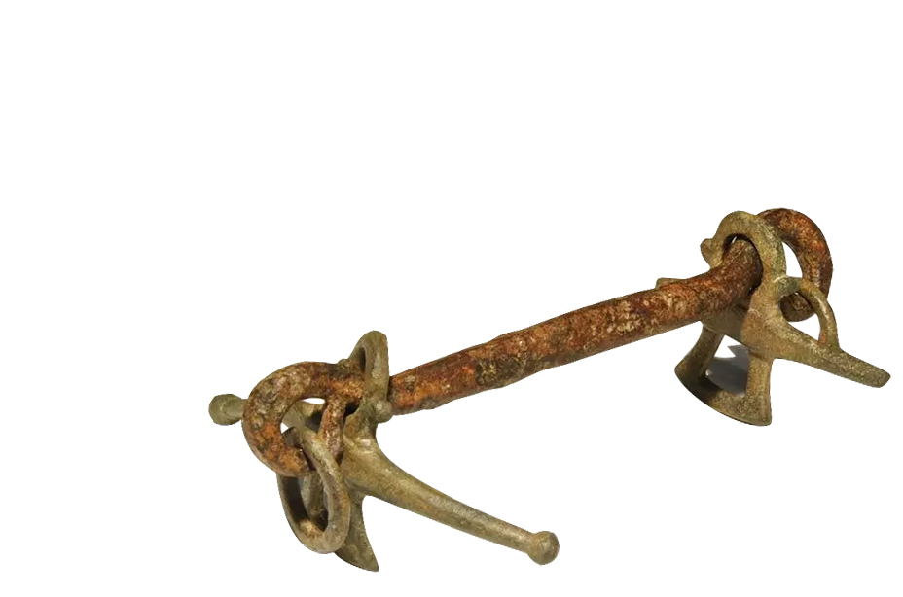
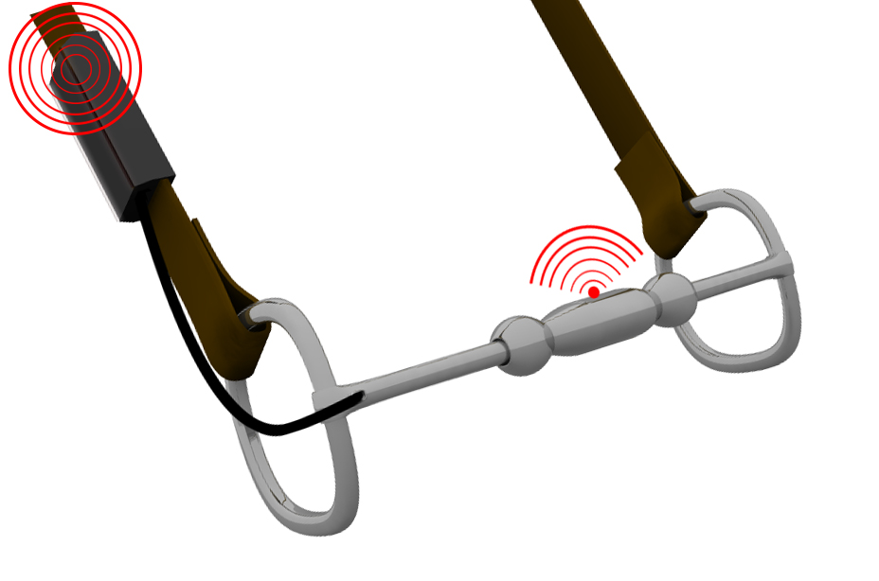
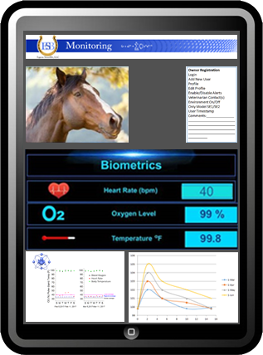
The Metal Horse Started Thousand of Years Ago
(Pictured left) 3,500-year-old Ancient Roman Horse bit
Introducing the World’s First
Smart Horsebit
IT ONLY TOOK 3,500 YEARS !
(Left Picture) ESB Model SO1
Equine SmartBit and Communicator
Patent Protected
USPTO AND PCT APP © All Rights Reserved

